Slide 1
Stacked LSTM Stock Price Prediction
Team 3: Yitian Wang, Zhixuan Li, Jason Liao, Sihan Zhou, Mia Kwon

Slide 2
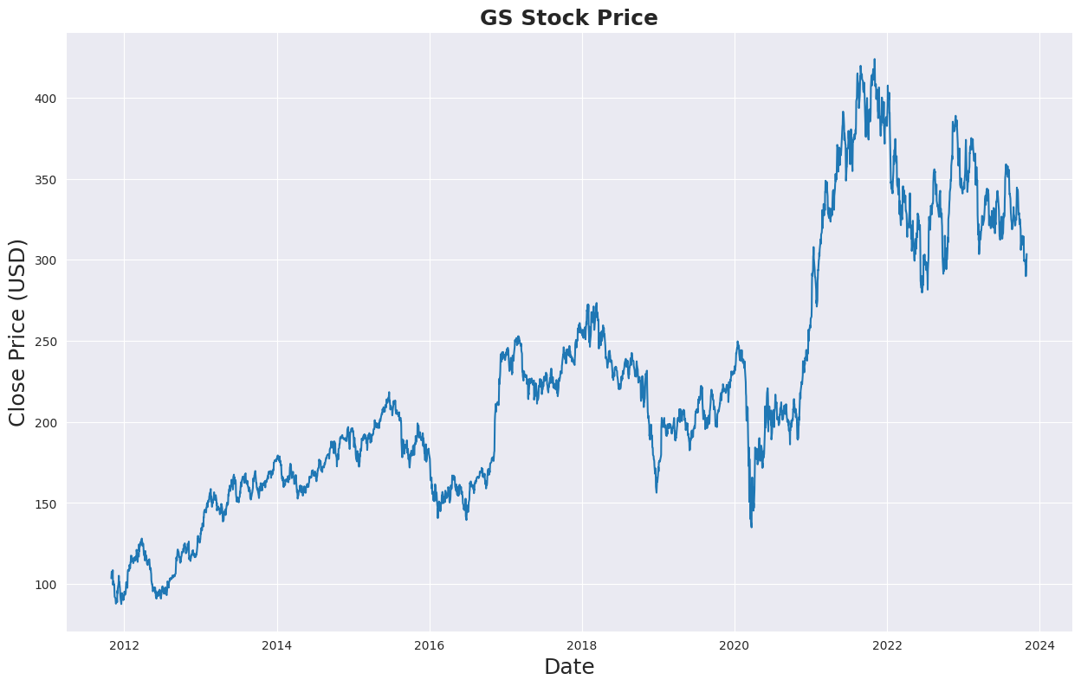
Market Need and Data Insight
Data Overview:
Discussing the comprehensive dataset used: Historical stock prices of Goldman Sachs from 2011 to 2023.
Includes key metrics like Open, High, Low, and Close prices, and the Volume of stocks traded, offering a complete picture of market movements.

Slide 3
Relevance and Business Impact
Revolutionizing Financial Sector
Accurate market trend forecasting for informed investment strategies
Applications in algorithmic trading and risk management
Portfolio optimization and financial advisory enhancements
Enhanced Decision Making and ROI
Data-driven approach reduces reliance on speculative methods
Accurate predictions for optimal investment timing, boosting ROI
Risk Mitigation in Investments
Early trend identification to minimize potential losses
Beneficial for risk-averse investors and large portfolio managers
Gaining Competitive Edge
Provides a significant advantage over firms not using advanced models
Highlights the need for balanced reliance on data-driven and qualitative analyses

Slide 4
Data Preparation Overview
Normalization Using MinMaxScaler
Scales each feature into a 0-1 range for feature uniformity
large input values (stock prices, in this case) can lead to larger error gradients, causing the learning process to oscillate wildly. Normalization helps in moderating the gradients
Sequence Formatting for LSTM
Transforms time series data into sequences with a 30-day lookback period
Aligns input sequences with target stock prices for the next day
Consistency and Robustness
Maintains data consistency across varying time periods
Increases model robustness against market fluctuations
Data Integration for Model Training
Segregates the dataset into training and testing sets
Facilitates model training and performance evaluation

Slide 5
Modeling Strategy
Stacked LSTM for Complex Data Interpretation
Ability to learn hierarchical representations from diverse market factors
Stacked LSTM was chosen for its proficiency in modeling time series data over alternatives. Standard LSTMs may struggle to remember information for long periods, but Stacked LSTMs, with their increased depth, can potentially capture long-term dependencies better, which is crucial for stock price prediction
Long-Term Dependency and Noise Robustness
Superior in capturing long-term dependencies compared to standard LSTM
Enhanced robustness against market noise and volatility
Model Architecture Details
Composed of multiple LSTM layers for learning temporal patterns
Includes a fully connected layer for precise output shaping
Hyperparameter Optimization
Tuning of hidden dimensions, layers, learning rate, dropout, and weight decay
Using Hyperopt package to tune the model

Slide 6
Implementation Overview
Overcoming Model Complexity
Tackled challenges of a multi-layered LSTM architecture through systematic coding and rigorous testing
Efficient GPU Utilization
Addressed CUDA-based GPU training challenges with precise tensor and model device management
Focused on Hyperparameter Optimization
Utilized Hyperopt for fine-tuning model parameters to optimize performance

Slide 7
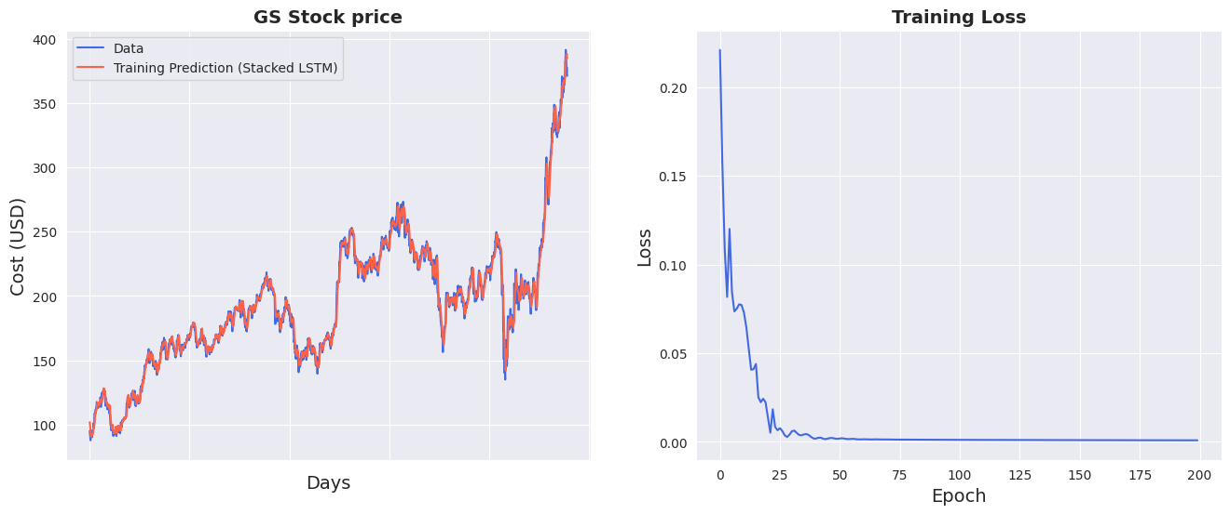

Slide 8
Results and Evaluation
Performance Metrics and Accuracy
Utilized RMSE to measure accuracy in predicting stock prices.
Achieved a training RMSE of 5.00 and a testing RMSE of 10.90.
Visual plots for comparing predictions with actual stock prices, enhancing interpretability.
Outperforming XGBoost Benchmark
Stacked LSTM model surpassed the XGBoost benchmark (RMSE of 18.07).
Demonstrates superior handling of temporal dependencies in stock market data.
In a larger dataset, ranging from 2001-2023, LSTM yields an RMSE of 20.39 but XGBoost has an RMSE of 67.87.
Repeated testing has shown consistent outperformance
Benchmarking Rationale
Compared with XGBoost, known for its efficacy in various data types and conditions for predicative analysis.
The comparison highlights the strengths of LSTM in time-series analysis over traditional models.

Slide 9
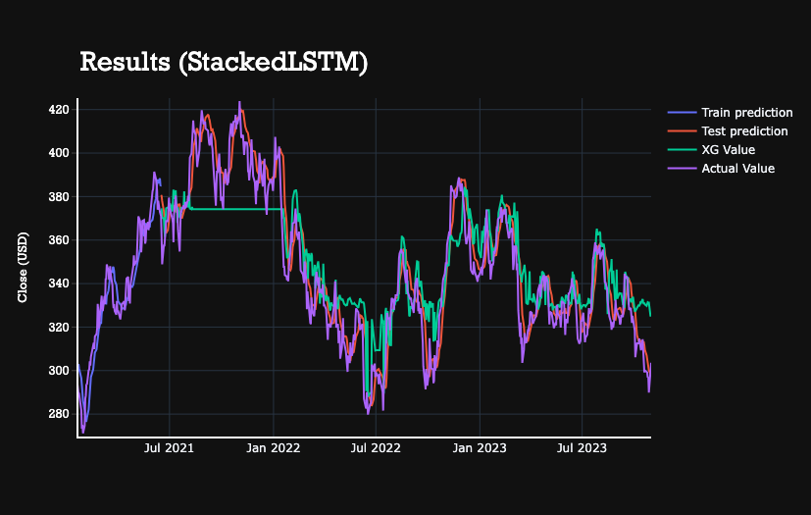
Results

Slide 10
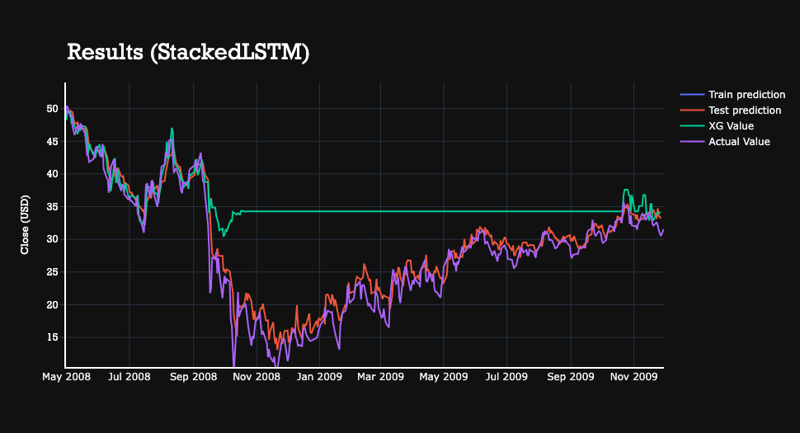
Additional Result
The above is the predicted prices for Morgan Stanley over 08' recession
We use Morgan Stanley's historical prices in this additional result since MS has a higher volatility compared to GS in 08' recession
The model improved in a more volatile time. It has a RMSE of 1.52 for training and 2.36 RMSE
Compared to the benchmark XGBoost model that has 10.21 RMSE, it produces a significant improvement. XGBoost seems unable to predict a value that it has not seen. The stacked LSTM does not have this limitation

Slide 11
Deployment
Flexible Deployment Options
Cloud-based deployment for scalability, accessibility, and handling large data volumes.
On-premise deployment for enhanced data security and control in sensitive financial environments.
Integration with Trading Platforms
Real-time analysis and decision-making capabilities through integration into trading platforms.
Use of APIs for direct model insights integration, ensuring operational efficiency and prompt market responses.
Maintaining Standards and Integrity
Focus on seamless model integration, data integrity, and adherence to performance and security standards.
Commitment to meeting the rigorous requirements of financial applications.
Ethical and Risk Management
Emphasize ethical transparency in AI-driven predictions.
Acknowledge and address the unpredictability of stock markets and potential risks of model misuse.

Slide 12
Thank You

